Slide 1
Impact of Covid, Global Recession & Russia Ukraine War on Global Economic Growth

Slide 2
Introduction
In this tableau analysis, we delve into the profound impacts of the COVID-19 pandemic, the global recession, and the Russia-Ukraine war on the intricate tapestry of global economic growth.
Unraveling the intricate threads of economic dynamics, this tableau presentation illuminates the interconnected repercussions stemming from the trifecta of the COVID-19 crisis, the global recession, and the ongoing Russia-Ukraine conflict.
Through the lens of Tableau, we navigate the intricate landscape of global economic growth, dissecting the multifaceted influences exerted by the COVID-19 pandemic, the reverberations of a global recession, and the geopolitical ramifications of the Russia-Ukraine war.

Slide 3
Target Audience
Tailored for economists, policymakers, and financial analysts, this presentation provides a comprehensive tableau analysis to aid in understanding the nuanced effects of the COVID-19 pandemic, global recession, and Russia-Ukraine conflict on economic landscapes.
Ideal for business leaders, investors, and decision-makers, this tableau exploration serves as a strategic guide, offering insights into navigating the intricate challenges posed by the interwoven forces of the COVID-19 impact, global recession, and geopolitical tensions.
Geared towards academics, researchers, and students in the fields of economics and international relations, this tableau-based study presents an in-depth examination of the symbiotic relationship between the COVID-19 crisis, global recession, and the Russia-Ukraine war, fostering a deeper comprehension of their collective impact on global economic growth.

Slide 4
Data Cleaning & Processing
Rigorous data cleaning and processing formed the foundation of our project, ensuring the integrity and reliability of our analysis by addressing inconsistencies, outliers, and missing values in the dataset.
A meticulous data cleaning and processing phase was undertaken to refine our dataset, involving the identification and rectification of anomalies, normalization of variables, and strategic handling of outliers to enhance the accuracy of our findings.
Leveraging advanced data cleaning techniques, we meticulously curated and processed our dataset, implementing thorough validation protocols to enhance the precision and credibility of our analytical insights.

Slide 5

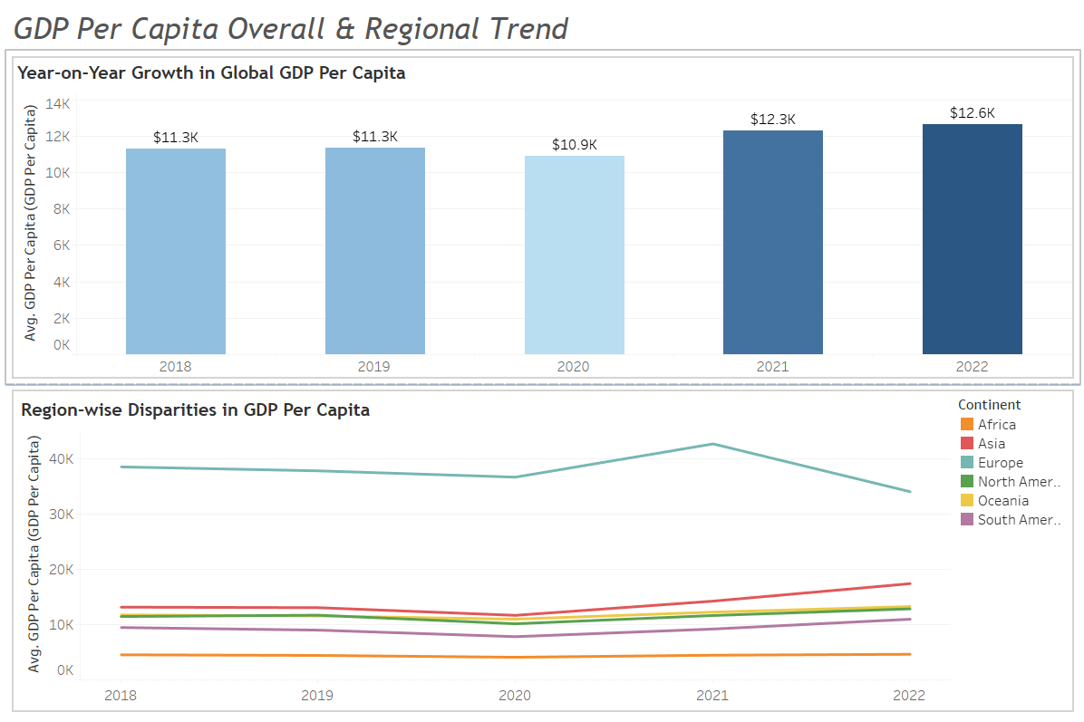
GDP Per Capita Overall & Regional Trend
Unveiling global economic nuances, the first insight showcases a consistent year-on-year rise in average GDP per capita, with a noteworthy surge from 2020 to 2021, indicating a robust recovery post-pandemic challenges. The second insight exposes continental disparities, highlighting Asia's robust growth, Europe's economic prowess, and South America's upward trajectory. In contrast, Africa grapples with lower figures, emphasizing diverse economic landscapes. The combined analysis provides a comprehensive view, offering insights into both the global and regional dimensions of economic well-being for informed policy and investment considerations.

Slide 6
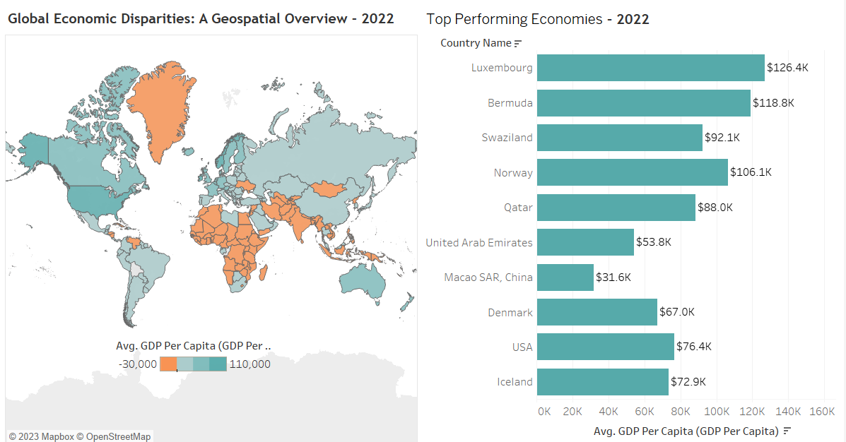
GDP Per Capita Map by Country and Top 10 Countries, Time Lapse
In our comprehensive analysis titled "Economic Landscape 2022," we uncover global economic disparities through a geospatial lens, examining the intricate interplay of GDP per capita across nations. The first insight showcases diverse latitudinal and longitudinal coordinates, revealing the economic impacts of geopolitical events, global recession, and the COVID-19 pandemic. Moving on to our second insight, encapsulated in "Top Performing Economies in 2022," we spotlight the economic powerhouses of the year. Macao SAR, China, and the United Arab Emirates lead a select group, highlighting resilient nations navigating challenges with robust GDP per capita figures. This dual-perspective tableau offers a nuanced understanding of the economic terrain, encapsulated in our comprehensive dashboard titled "Economic Powerhouses Snapshot."

Slide 7
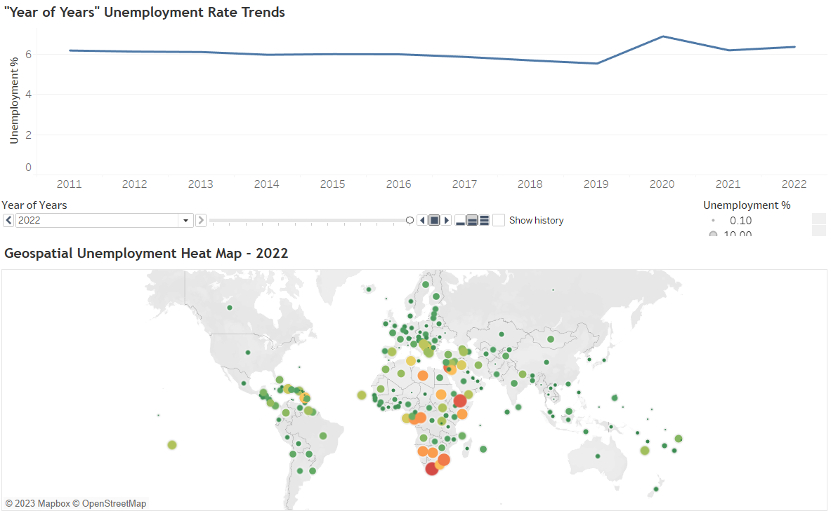
Unemployment Global & Over the years Trend
This comprehensive analysis unveils the intricate tapestry of global economic dynamics, combining insights from both "Year of Years" unemployment trends and the geospatial variation in 2010. The gradual rise in global unemployment rates, punctuated by peaks in 2020 and 2022, reflects the profound impact of events like the COVID-19 pandemic. Simultaneously, the geospatial analysis provides a nuanced understanding of regional disparities in unemployment, offering valuable context for the broader socio-economic landscape. Explore the evolution of global unemployment and its geographic nuances over the past decade.

Slide 8
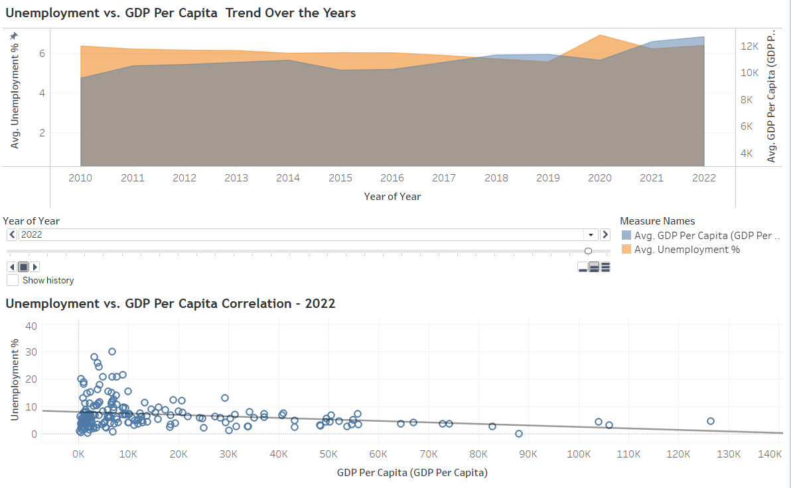
Unemployment vs. GDP Percapita Trend and Correlation by Countries
Explore the evolving global economic landscape through a comprehensive analysis spanning from 2010 to 2022. Witness a consistent rise in average GDP per capita, peaking at $12,647.48 in 2022. However, the accompanying fluctuation in unemployment rates unveils intricate shifts in economic stability. Moving beyond averages, Insight 2 zooms into the regional disparities in 2022, highlighting countries like Qatar with a minimal 0.095% unemployment rate and South Africa grappling with a substantial 29.806%. This amalgamation of insights provides a holistic understanding of both long-term trends and immediate disparities, contributing to a nuanced perspective on global economic health.

Slide 9
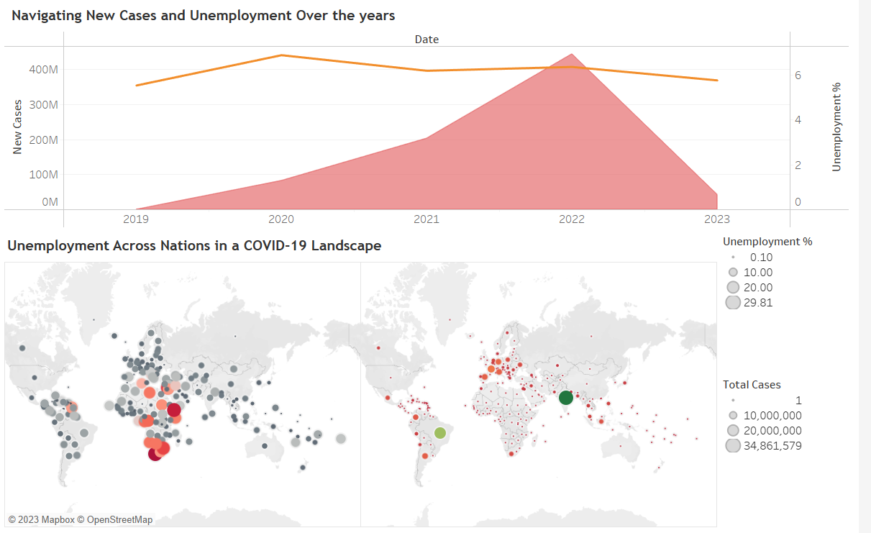
Impact of Covid on Unemployment, and Regional Impact
This comprehensive analysis explores the intricate relationship between the surge in new COVID-19 cases, fluctuations in unemployment rates, and geographical disparities in economic impacts. The visualization not only underscores the correlation between the health crisis and economic downturns but also sheds light on how different nations grapple with the dual challenges of the pandemic and economic instability. From the economic waves of unemployment to the geographical hotspots of crisis, the data paints a holistic picture of the multifaceted global challenges.

Slide 10
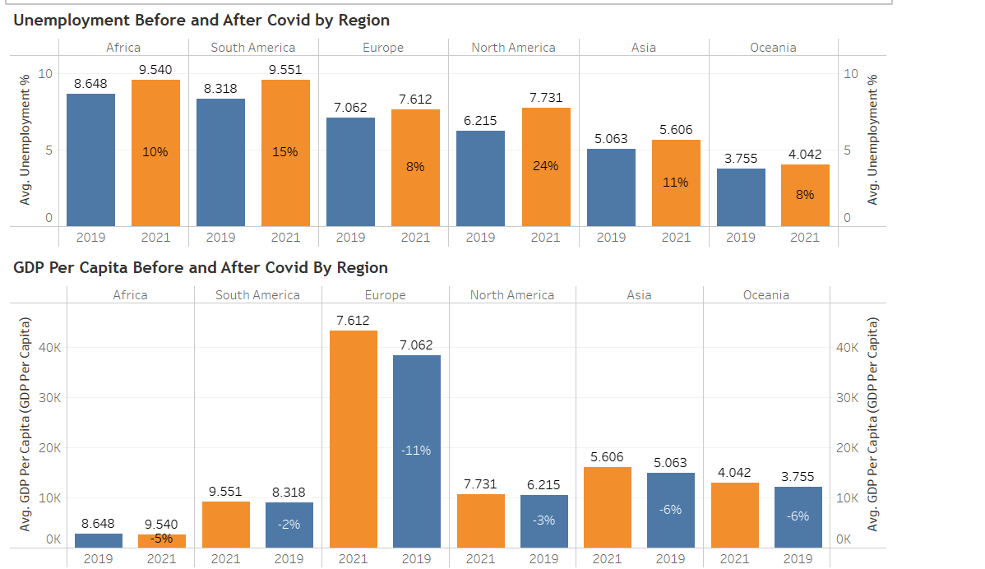
Regional Comparison by Unemployment & GDP percapita, Before and During Covid
This comprehensive analysis delves into the intricate tapestry of global economic health, juxtaposing unemployment trends and GDP per capita changes across continents from 2019 to 2021. Europe's notable 7.78% rise in unemployment contrasts with a substantial 7.61% increase in GDP per capita, offering insights into the region's economic complexities. Meanwhile, North America experiences a significant 24.40% spike in unemployment, underscoring the profound impact of external factors. This dashboard provides a holistic view, highlighting the delicate balance between prosperity and employment on a global scale.

Slide 11
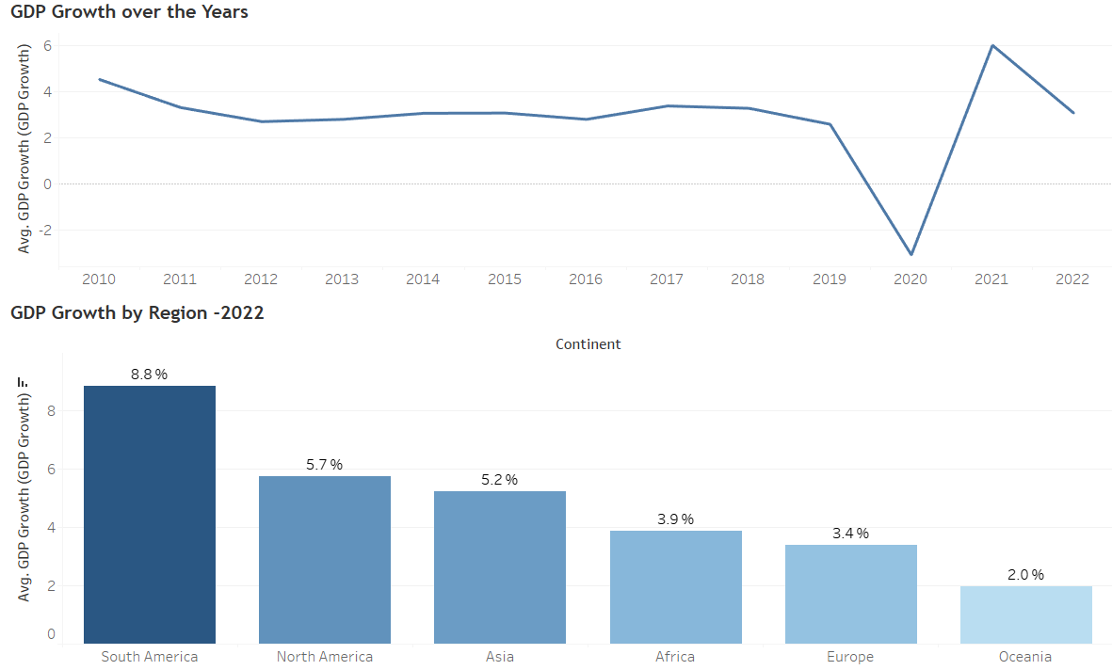
GDP Growth Rate Trend over the Years and by Region
The insights reveal a fluctuating global economic landscape. In 2020, the global GDP experienced a sharp decline of -3.07%, likely due to the COVID-19 pandemic. However, the subsequent year witnessed an impressive rebound with a remarkable 6.02% growth. The year-on-year analysis underscores the resilience and recovery of the global economy. Furthermore, examining GDP growth across continents demonstrates varying economic performances. South America stands out with an impressive 8.84% average growth, while Asia and North America follow closely with 5.22% and 5.73%, respectively. Europe and Africa also exhibit strong growth at 3.38% and 3.88%, emphasizing the diverse economic dynamics across different regions.

Slide 12
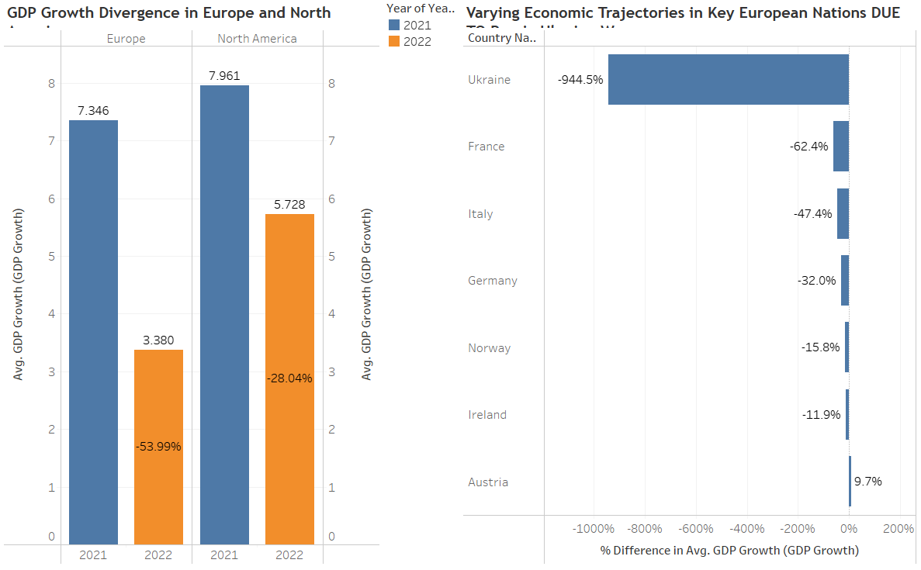
Impact of Ukraine War On NA & European GDP Growth
Amidst the Ukraine War, our analysis unveils a staggering rise in inflation rates across key years, reaching a peak in 2022. The first insight portrays the intensification of economic challenges during this period. Additionally, our second insight zooms into the North American region, highlighting varying inflation rates in Canada, Mexico, and the United States. The dashboard, titled "Global Economic Turmoil: Insights from the Ukraine War," provides a comprehensive view of inflation dynamics during this critical juncture

Slide 13
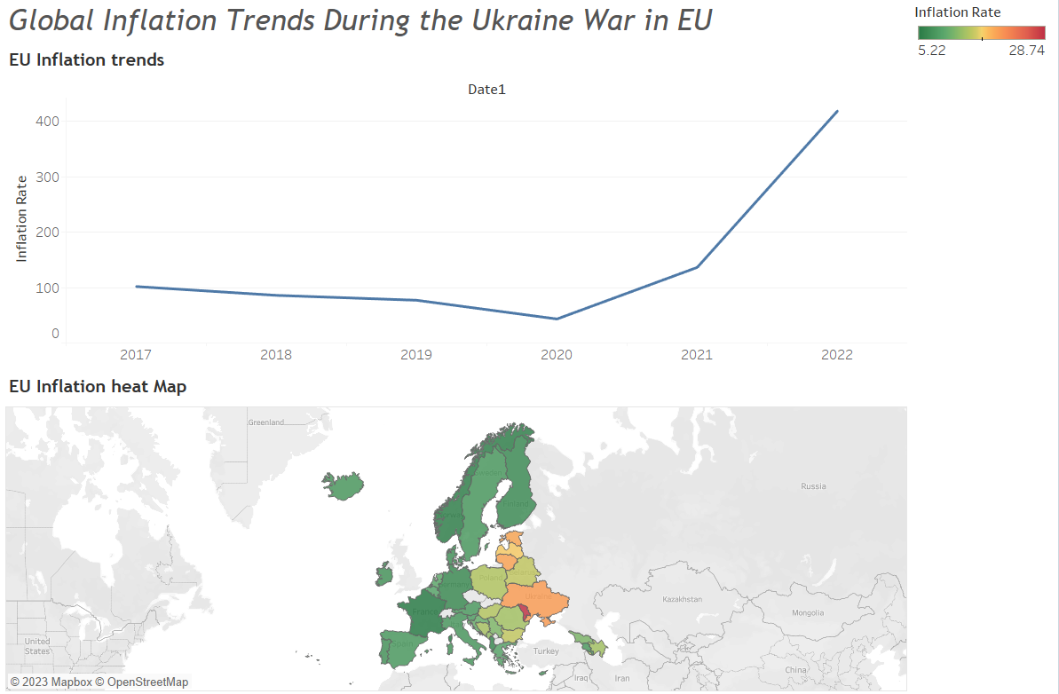
Global Inflation Trends During the Ukraine War in EU
Delving into the economic repercussions of the Ukraine war using Tableau, our analysis unfolds a significant surge in global inflation rates during 2022, reaching an alarming 418.74%. This insight, presented under the title "Inflation Dynamics Amidst Conflict," emphasizes the profound economic impact of geopolitical tensions. Additionally, our exploration of varied regional trends, titled "Regional Disparities in Inflation Trends," unveils nuanced consequences across European nations. The comprehensive dashboard, titled "Global Inflation Landscape," provides a holistic view for policymakers and businesses navigating the intricate aftermath of the Ukraine conflict on international economic stability.

Slide 14
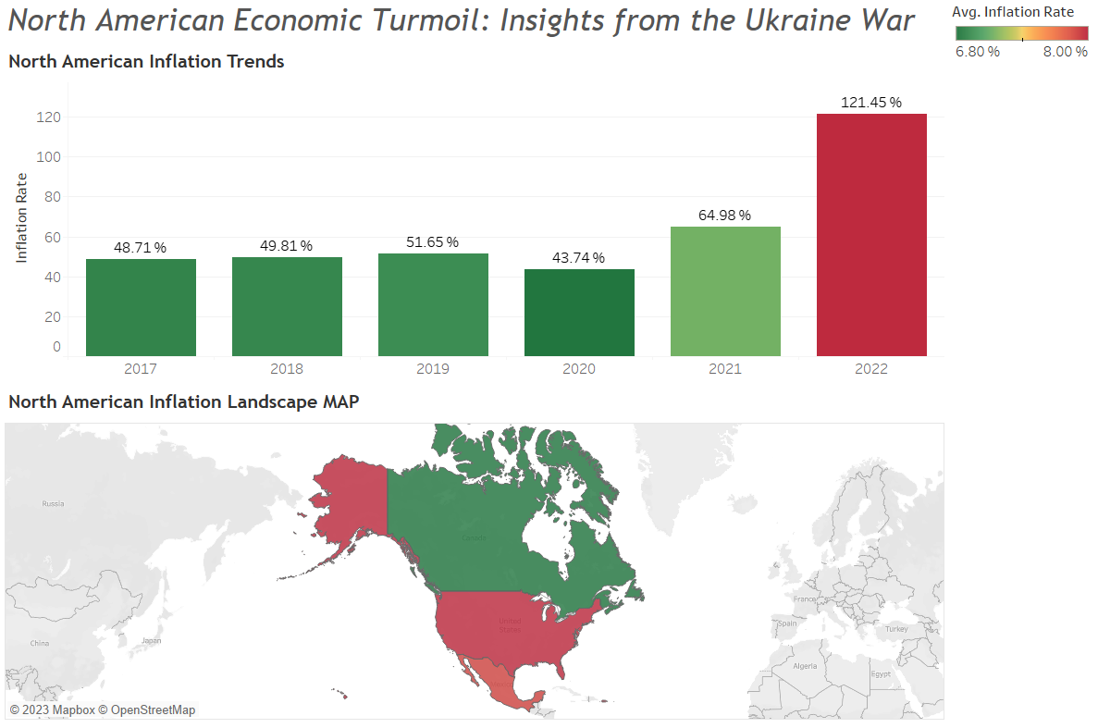
Amidst the Ukraine War, our analysis unveils a staggering rise in inflation rates across key years, reaching a peak in 2022. The first insight portrays the intensification of economic challenges during this period. Additionally, our second insight zooms into the North American region, highlighting varying inflation rates in Canada, Mexico, and the United States. The dashboard, titled "Global Economic Turmoil: Insights from the Ukraine War," provides a comprehensive view of inflation dynamics during this critical juncture.

Slide 15
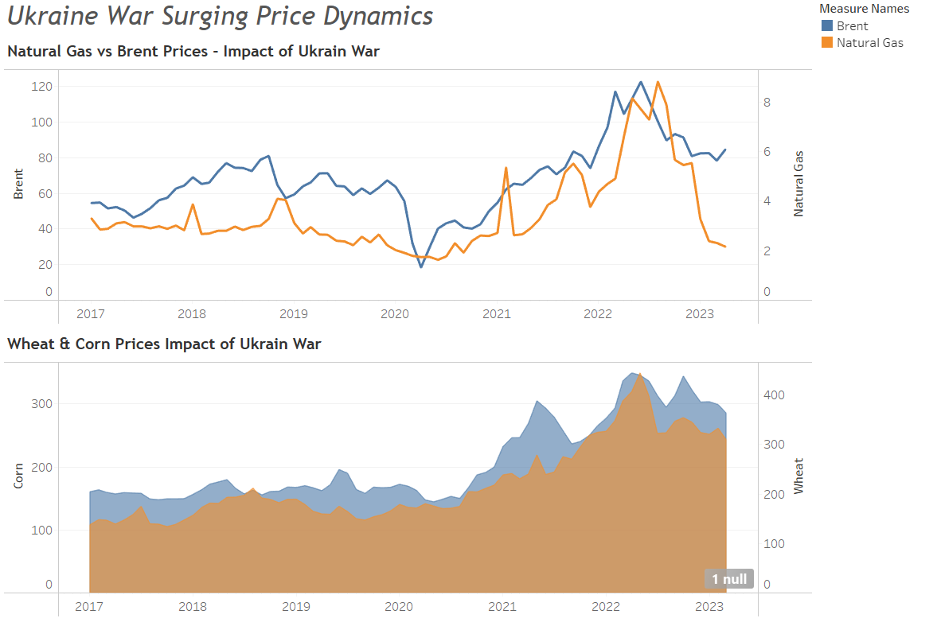
Ukraine War Surging Price Dynamics
The dataset reveals a multifaceted story of the global economy amidst the Ukraine war. While Natural Gas and Brent Crude prices experience unprecedented fluctuations, showcasing the energy sector's vulnerability, Wheat and Corn prices surge amidst global uncertainty. This analysis underscores the intricate interplay between geopolitical events and economic variables, urging a comprehensive understanding of how energy and agricultural markets respond to the ever-changing global landscape.

Slide 16
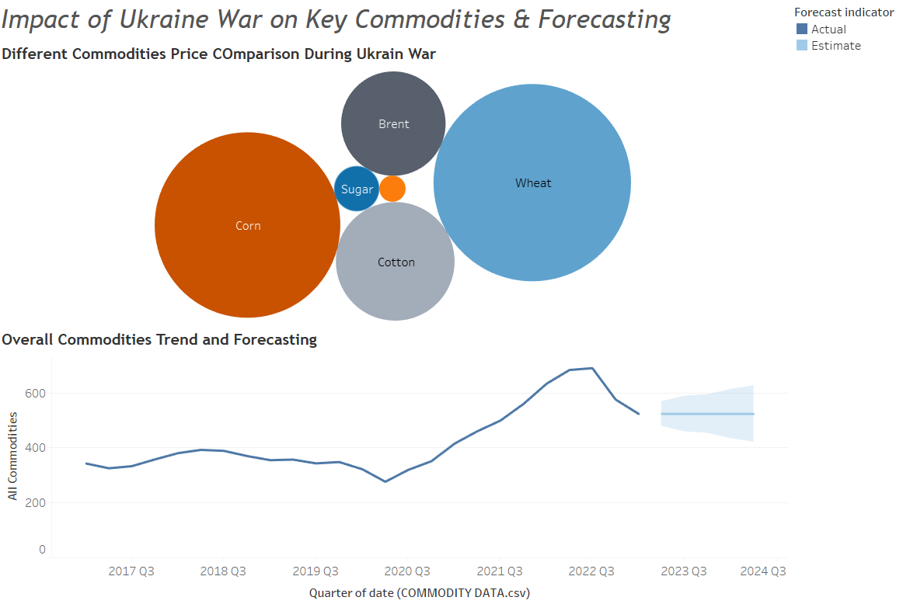
This comprehensive analysis explores the impact of the Ukraine war on key commodities such as Sugar, Natural Gas, Cotton, Brent, Wheat, and Corn, revealing significant price surges. Simultaneously, the forecast indicators for various commodities project a dynamic future, emphasizing the need for strategic economic resilience amid geopolitical uncertainties. The dashboard provides a holistic view, aiding stakeholders in crafting proactive strategies to navigate the evolving landscape of global economic volatility.

Slide 17
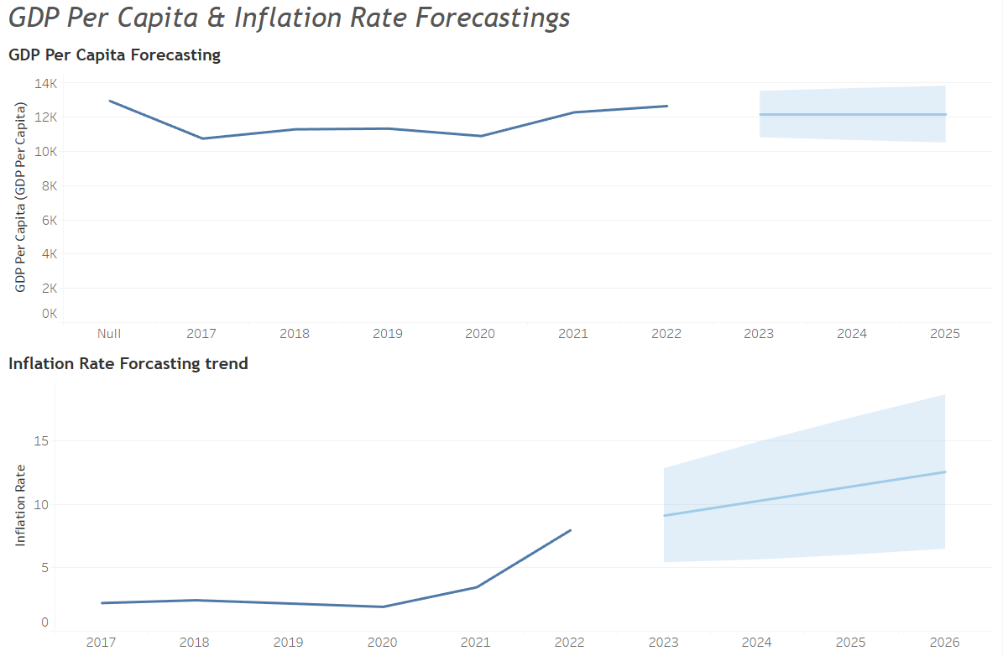
This comprehensive analysis explores the economic landscape during the Ukraine conflict, revealing intriguing trends. Despite geopolitical challenges, the GDP per capita exhibits resilience, with consistent growth projected from 2023 to 2025. Concurrently, inflation rates surge initially but show signs of stabilization by 2026. Unveiling economic intricacies, this dashboard, "Navigating Economic Resilience: Ukraine War's Impact," provides a nuanced understanding of how Ukraine's economy navigates the turbulent geopolitical waters.

Slide 18
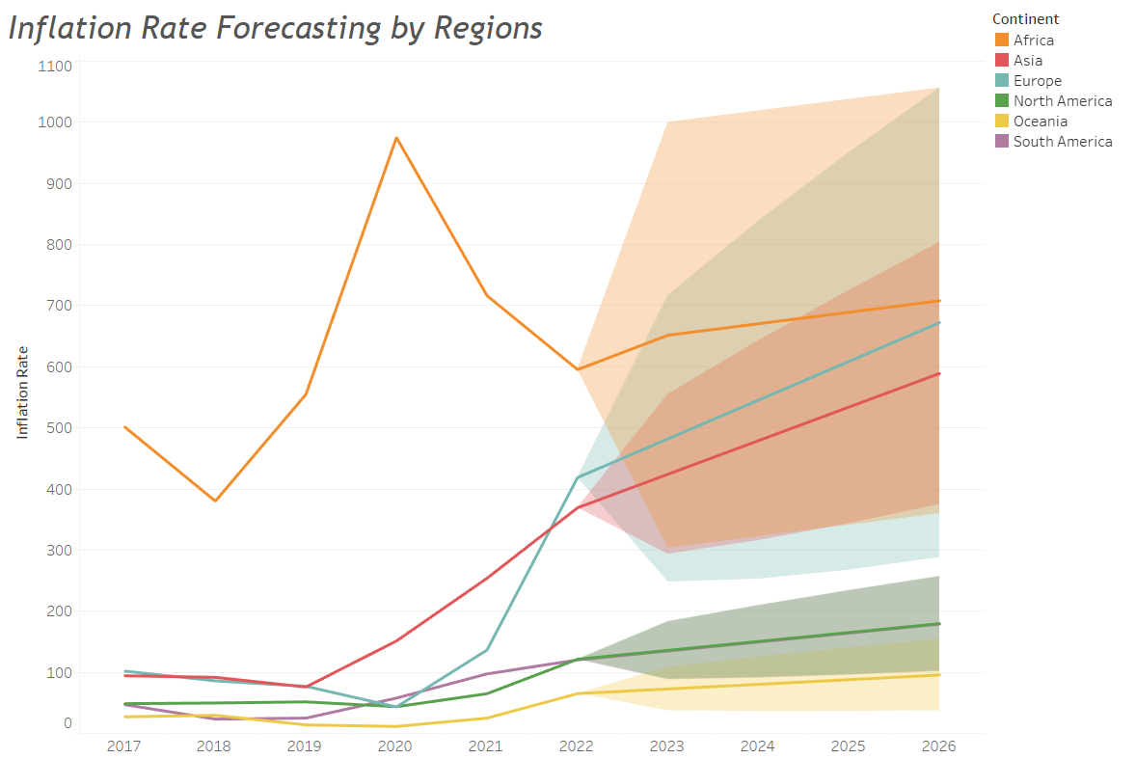
This comprehensive analysis explores the economic ramifications of the Ukraine War across continents. In the spotlight are two pivotal insights: Africa faces a formidable challenge with a surge in predicted inflation rates, reaching between 303.32 and 999.87 in 2023. Simultaneously, Asia undergoes pronounced fluctuations, showcasing a predicted inflation range from 293.35 to 555.02. Together, these insights illuminate the intricate interplay of geopolitical tensions on a global scale, shaping the economic trajectory amidst the ongoing conflict.

Slide 19
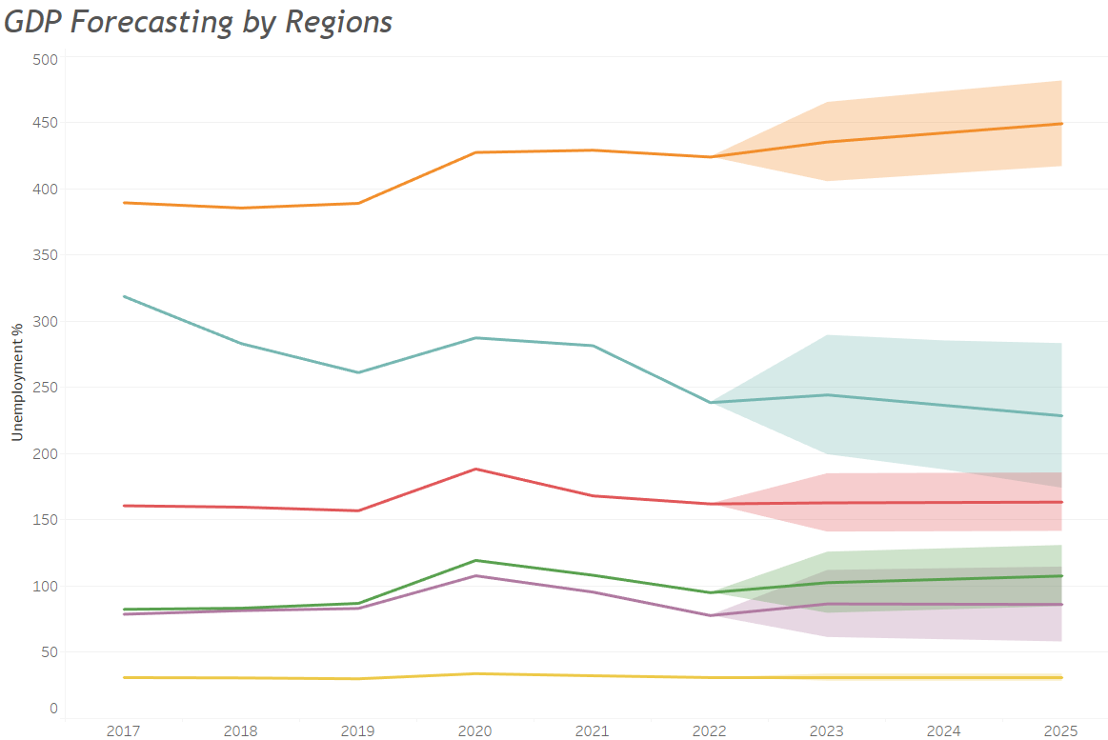
During the Ukraine War, our analysis reveals nuanced patterns in unemployment rates and GDP growth across continents. Africa anticipates a gradual decline in unemployment, while Asia experiences fluctuations. Europe faces uncertainty with a wide range in unemployment intervals, and North America sees a potential stabilization. Oceania maintains relative stability, while South America faces considerable volatility. This comprehensive dashboard titled "Global Economic Resilience Amidst Geopolitical Turmoil" captures the intricate economic dynamics during this period, offering a holistic view of the world's economic responses.

Slide 20
References:
https://data.worldbank.org/indicator/NY.GDP.PCAP.CD
https://www.kaggle.com/datasets/debashish311601/commodity-prices/discussion
https://data.worldbank.org/indicator/FP.CPI.TOTL.ZG

